Slide 1
Should a basic understanding of Computer Science be taught along GIS?
By: Christopher Chen

Slide 2
Why should some aspects of Computer Science be taught along GIS?
Python, a scripting language, is a standard language of GIS
Many of the applications within GIS are Python
Used to automate geoprocessing task
All geoprocessing tools are based in Python and can be integrated into programs

Slide 3
Example of Python Code:
Using the New Jersey County Shapefile creating a program to :
Compare two populations of a county in 2010 and 2000 and create a separate table in a Geodatabase to display each population difference in the attribute table

Slide 4
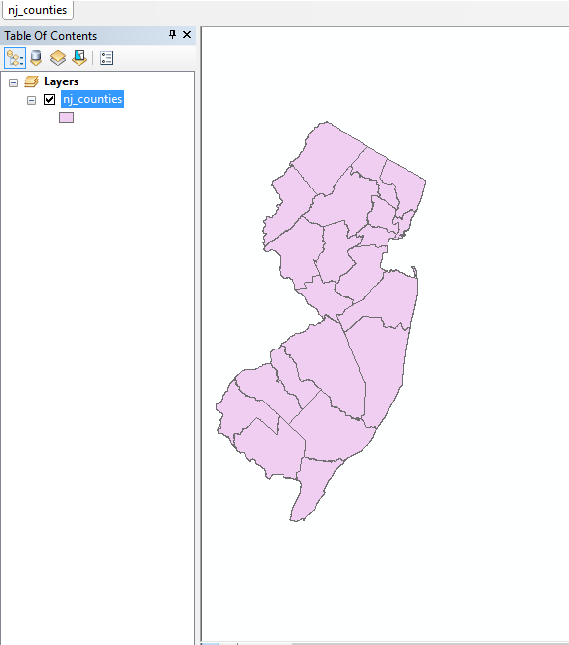

Slide 5
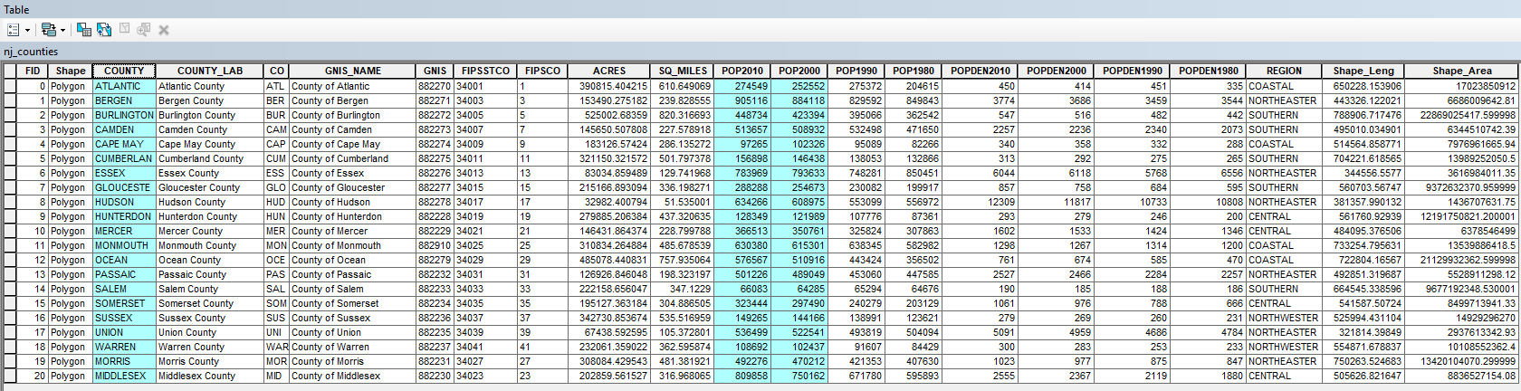

Slide 6
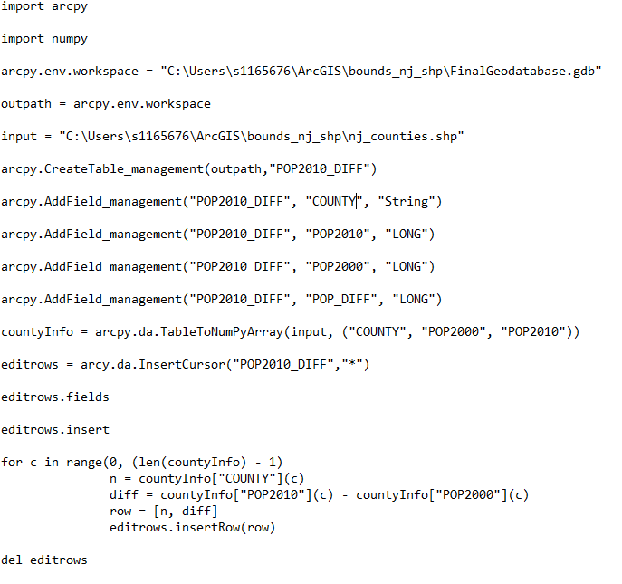

Slide 7
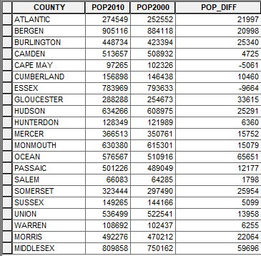

Slide 8
Conclusion:
Learning the basics of coding can allow for more options when it comes to geoprocessing information
Allows for combinations of already established tools to preform certain task
Create new/custom geoprocessing tools

